Slide 1
Final Capstone project Report
AlJannat A. Uthman

Slide 2
Agenda
CASE 0 Summary
Analysis and Findings​
CASE 1 Summary
Analysis and Findings

Slide 3
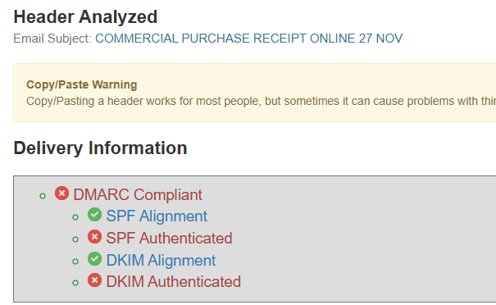
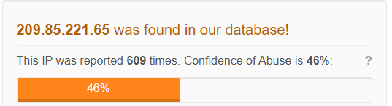
CASE 0 SUMMARY
I responded to an alert about a potential phishing email targeted at faculty members of the educational institute. The email appeared to come from a trusted entity who claims to be a Magister in Education and LEB Teacher at FESAD. After thorough analysis and deep investigation, it turned out to be a true positive.

Slide 4
Analysis and findings
Header, Body, and Attachment Analysis.
Recommendations and Conclusion.

Slide 5
Analysis and findings
HEADER ANALYSIS
RED FLAGS
BODY ANALYSIS
From: ERIKA JOHANA LOPEZ VALIENTE <erikajohana.lopez@uptc.edu.co>
Date: Thu, 9 Dec 2022 09:58:26 +0100
Subject: COMMERCIAL PURCHASE RECEIPT ONLINE 27 NOV
To: undisclosed-recipients:;
X-TM-Authentication-Results: spf=pass (sender IP address: 209.85.221.65)
Return-Path: erikajohana.lopez@uptc.edu.co
Sender IP address has been reported 600+ times according to AbuseIPBD.
The absence of a value in the To field confirms that the email was sent to multiple recipients.
Even though it passed the spf check, analyzing the headers with MX toolbox shows that the email domain - uptc.edu.co is not DMARC compliant. Cross checking this fact with PhishTool suggests the same.
Analyzing further on VirusTotal shows that the IP address - 107.175.247.199 is linked to domain - ripley.studio which has been repeatedly reported as malicious. The domain communicates files like install.exe.
There is use of fear tactics.
The attachment of a link to download an invoice instead of the standard practice of attaching a file.
The link shows that an exe file will be downloaded instead of text files like pdf, xlsx etc.

Slide 6

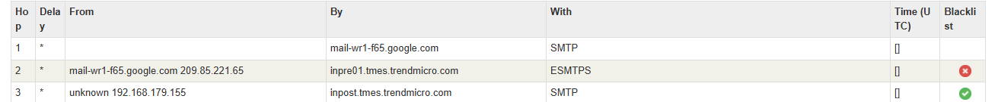
Proof of findings:
.

Slide 7
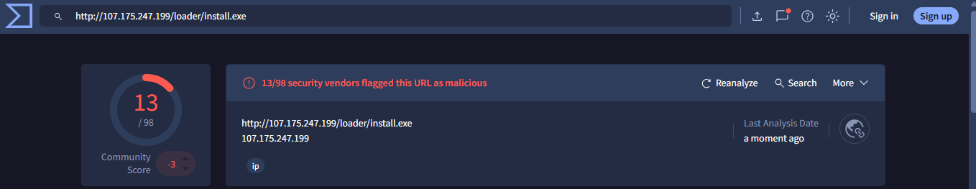
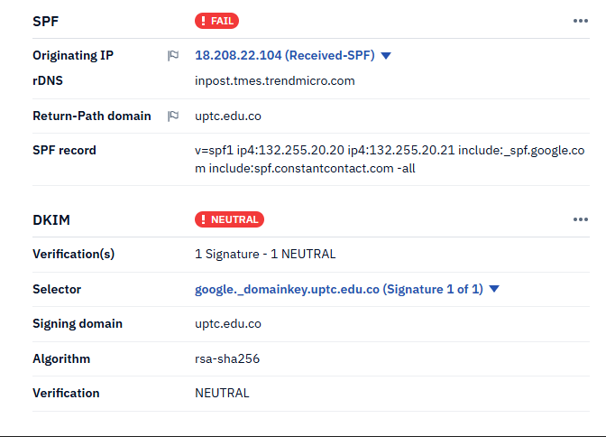
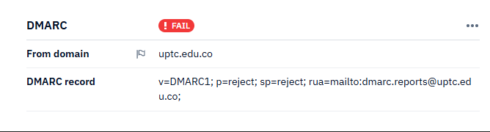
Further analysis & Indicators of compromise (IOCs)
Type | Indicator
Domain | uptc.edu.co
IP | 107.175.247.199
Sender IP | 209.85.221.65
URL | http://107.175.247.199/loader/install.exe

Slide 8
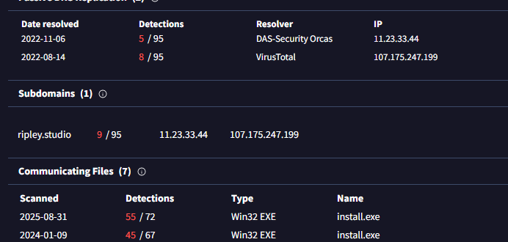
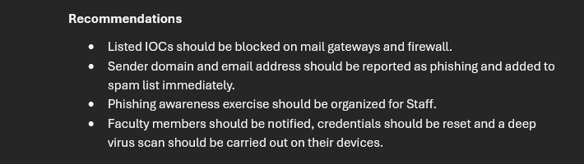
MALICIOUS!
The email poses a high risk due to the multiple indicators that affirm that the sender has a malicious intent.
Verdict: The phishing alert is a true positive as confirmed by the multiple indicators of compromise. The email should be flagged as a phishing mail and response actions such as containment, eradication and recovery should be taken with immediate effect.

Slide 9
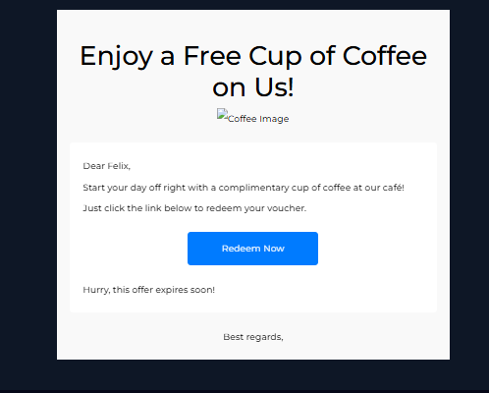

CASE 1 SUMMARY
While monitoring the institution’s email security dashboard, I observed an email sent to a fellow employee which has a link attachment that prompts the recipient to redeem a free voucher.

Slide 10
Analysis and findings
Log, Body, and Attachment Analysis.
Recommendations and Conclusion.

Slide 11
Analysis and findings
LOG ANALYSIS
RED FLAGS
BODY ANALYSIS
From: free@coffeeshooop.com
To: Felix@letsdefend.io
Subject: Free Coffee Voucher
Date: May, 13, 2024, 09:22AM
Action: Allowed
Looking up the record of the domain – coffeeshoop.com with two different services shows that it has never been registered before. This reveals that the domain was spoofed and that it might be a case of clone phishing.
There is an element of urgency in the body of the email. The recipient is being urged to click the link attached.
The attached image looks broken and this can signify a number of suspicious happenings including blockage by email client, imperfect mimicking of a legitimate template and the image might be hosted on a suspicious domain amongst other reasons.

Slide 12
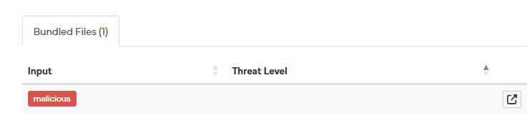
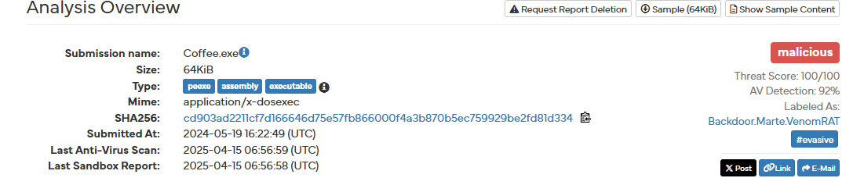
Analysis and findings
ATTACHMENT ANALYSIS
VirusTotal analysis reveals that the URL has been flagged as malicious by a few vendors.
In the Relations tab, Sophos classified it as malware and spyware.
The value of the Final URL reveals a hash of the file - 59cbd215-76ea-434d-93ca-4d6aec3bac98. Analyzing the hash on VirusTotal showed no suspicion neither was it flagged by any vendor. However, analyzing it with Hybrid Analysis confirmed that the link does downloads a Trojan malware.

Slide 13
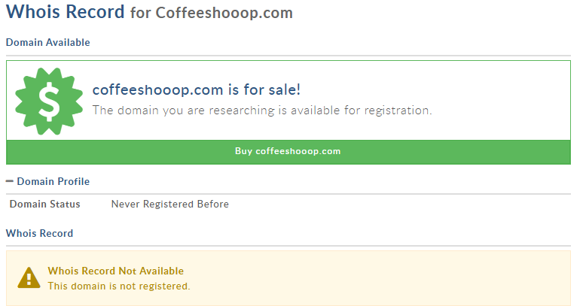
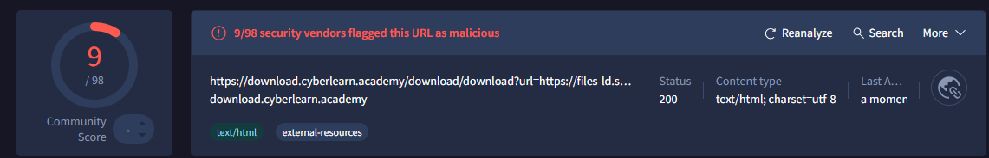
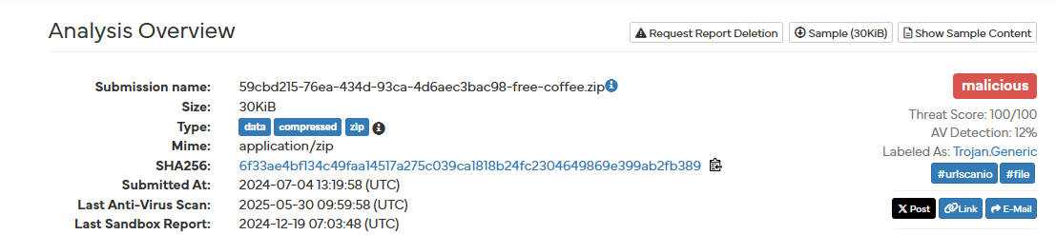
Proof of findings:
.

Slide 14

Further analysis & Indicators of compromise (IOCs)
Domain | coffeeshooop.com
File Hash | 59cbd215-76ea-434d-93ca-4d6aec3bac98
URL | https://download.cyberlearn.academy/download/download?url=https://files-ld.s3.us-east-2.amazonaws.com/59cbd215-76ea-434d-93ca-4d6aec3bac98-free-coffee.zip
Domain | coffeeshooop.com

Slide 15
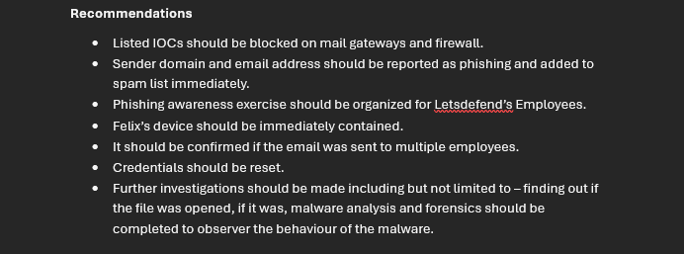
MALICIOUS!
The email poses a high risk due to the multiple indicators that suggests that the sender is a bad actor with the most threatening indicator being the attachment of a trojan file.
Verdict: The incoming mail was a phishing attempt as confirmed by the multiple indicators of compromise. The recommendations should be acted on and response actions such as containment, eradication and recovery should be taken with immediate effect.

Slide 16



Thank you
AlJannat A. Uthman
AlJannat A. Uthman
https://theliljannah.github.io/TH3LILJ4NN47/

